Slide 1
Airbnb Host Revenue Prediction

Slide 2
Objective
Optimizing revenue and booking rate
Create a platform for Airbnb to process, transform, store data of different cities
Analyse and model the data to get useful insights with a user interface to display these insights

Slide 3
Road Map
Data Warehouse
Data Science Lifecycle
Data Engineering Pipeline
Insights UI
Generalization
Deployment
Internal UI

Slide 4
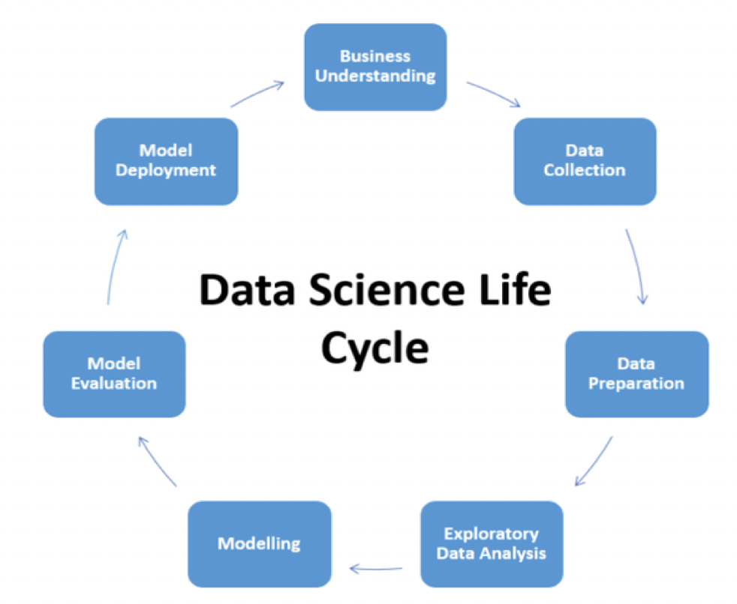
Data Science Lifecycle

Slide 5
Data Collection
Process of collecting data to solve business problem
Datasets of listings and calendar representing multiple listings for each host
http://insideairbnb.com/get-the-data/

Slide 6
Data preparation
Most time consuming stage
Tasks
Merging datasets
Imputing
Outcome : preprocessed dataframe

Slide 7
Exploratory Data Analysis (EDA)
Analyse datasets by visualization
Tasks
Category counts
Correlations
Importance: Understanding dataset

Slide 8
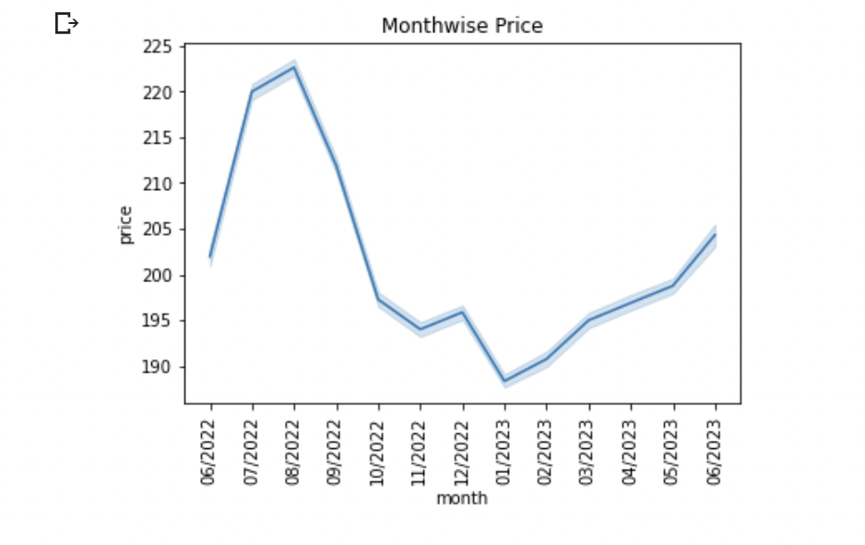

Slide 9
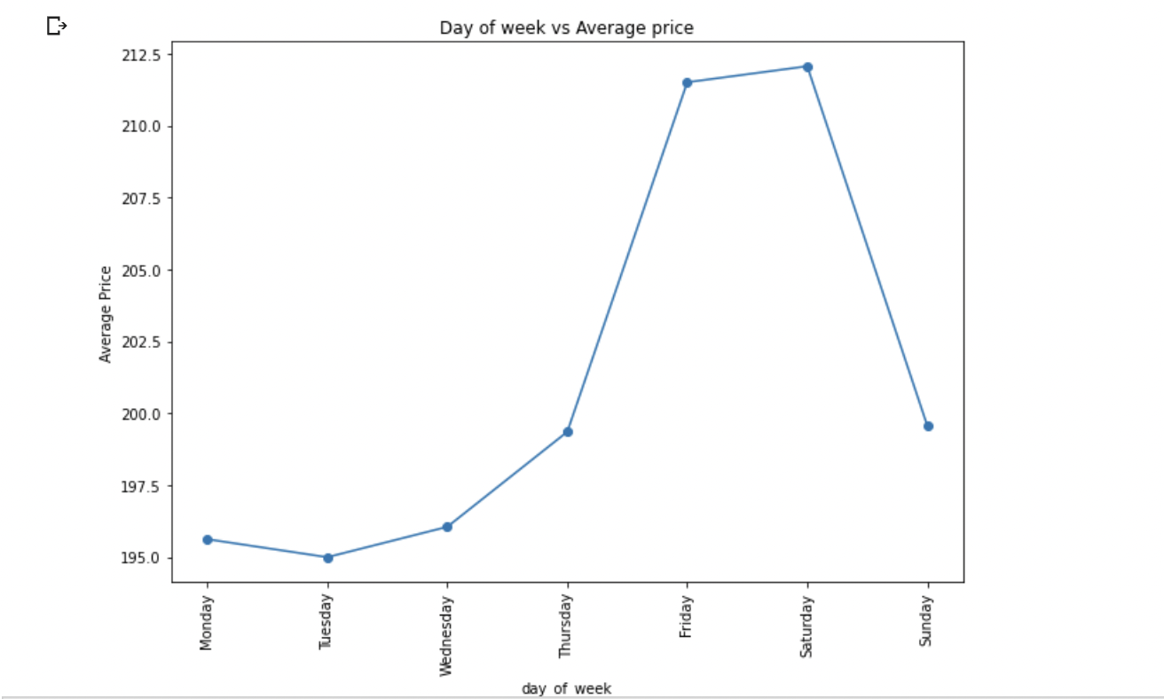

Slide 10
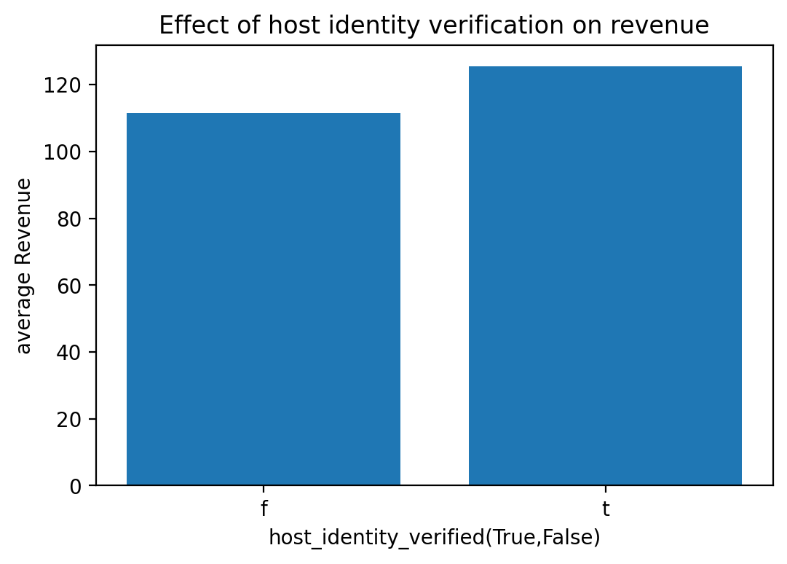

Slide 11
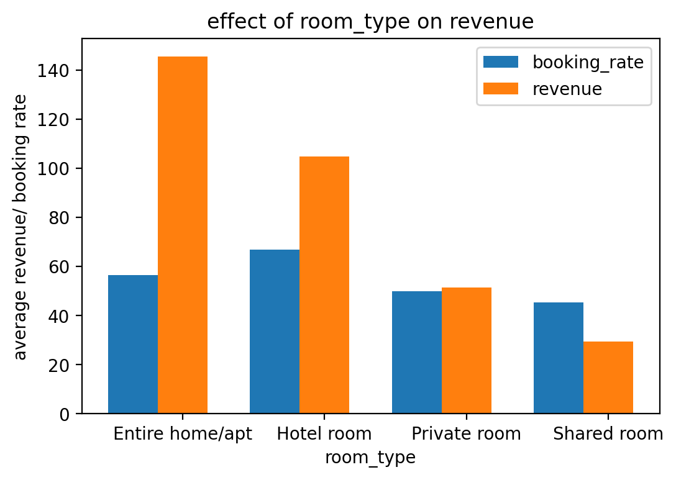

Slide 12
Feature Engineering
Isolating consistent, relevant features, creation of new features
Improve model performance
Reduce the computational cost of modeling
The most important -
Curse of dimensionality

Slide 13
Modeling
Machine learning model ?
Computer program to learn from data and make predictions
Revenue and booking prediction
Supervised learning model
Regression problem
Model outcome : revenue or booking rate % for unlabelled data

Slide 14
Modeling ALgorithms
K Nearest Neighbors
Support Vector Regression (SVR)
XGBRegressor
Random Forest
Linear Regression
Regularization
Ridge
Lasso
Polynomial
Ridge
Lasso

Slide 15
Model Evaluation
Evaluation metrics
To find generalized model
Different regression metrics
Mean Absolute Error(MAE)
Mean Squared Error(MSE)
RMSE
R squared

Slide 16
Model | R2 score
K Nearest Neighbors | 0.8450578330169121
SVR - Linear | 0.7852993518404301
SVR - Radial | 0.4949102276874262
XGBRegressor | 0.9533370165073544
Random Forest | 0.8810420834518464
Linear Regression | 0.8068319637301892
Ridge Regularization | 0.8067676164771325
Lasso Regularization | 0.8069592093371641
Polynomial with Ridge | 0.8067676164771325
Polynomial with lasso | 0.9802121530953398

Slide 17
Model Deployment
Don’t stop yet.
Help users in practical decision-making.
Impactful insights to help in business growth.

Slide 18
Generalization
Inferring patterns from the previous step
Object oriented programming
Configurable and Modularized

Slide 19
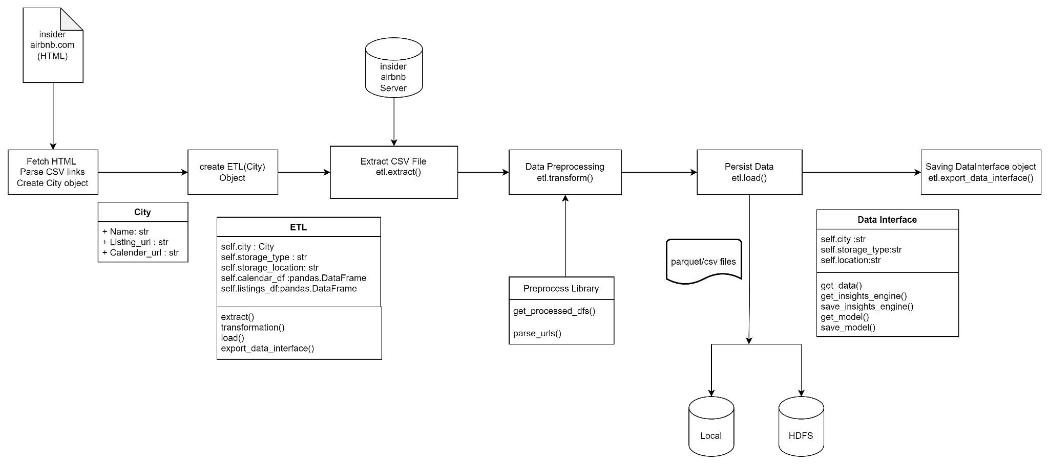
ETL

Slide 20
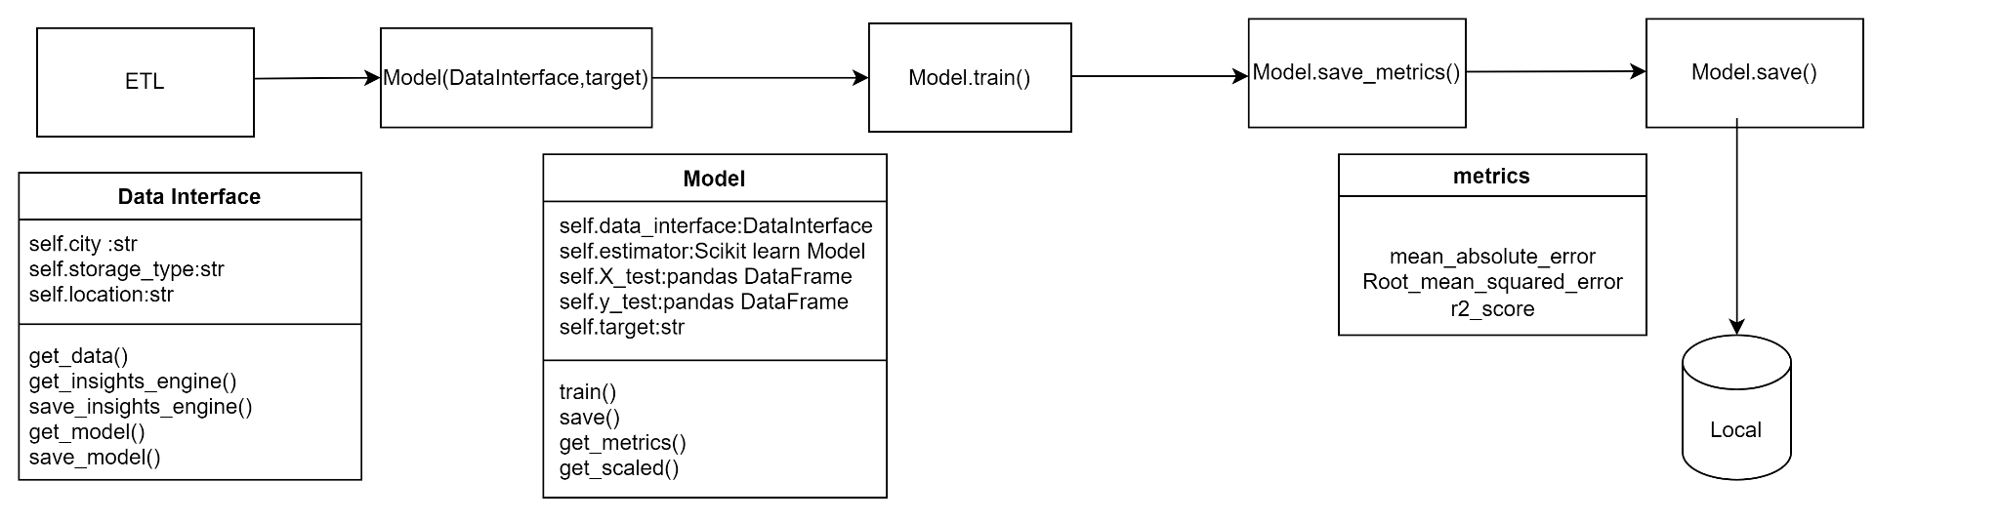
Modelling

Slide 21
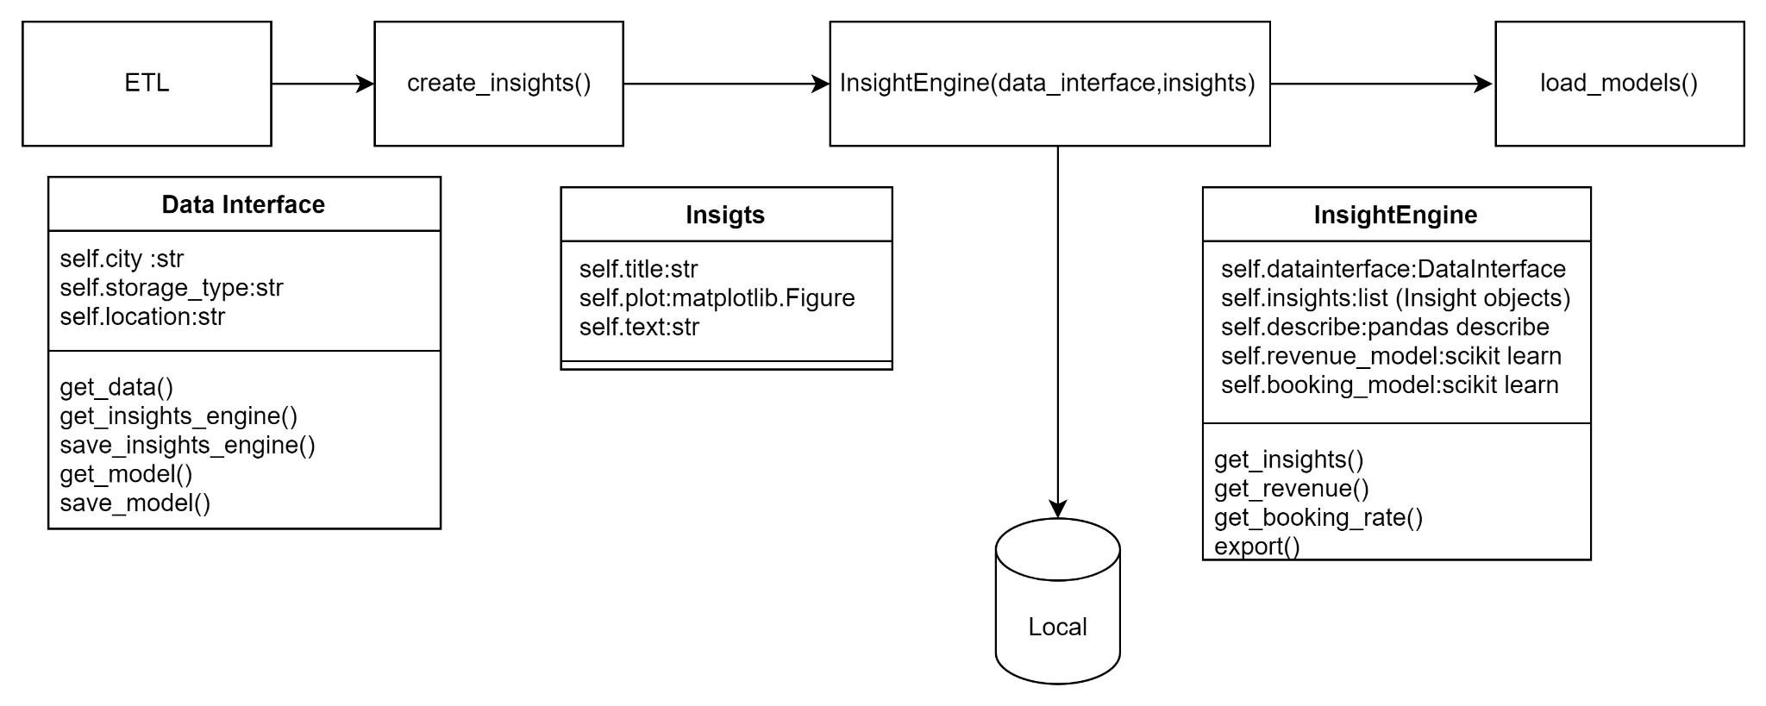
Insights

Slide 22
Streamlit
Open source web application framework.
Web apps for data science and machine learning.
Compatible with major Python libraries such as scikit-learn.

Slide 23
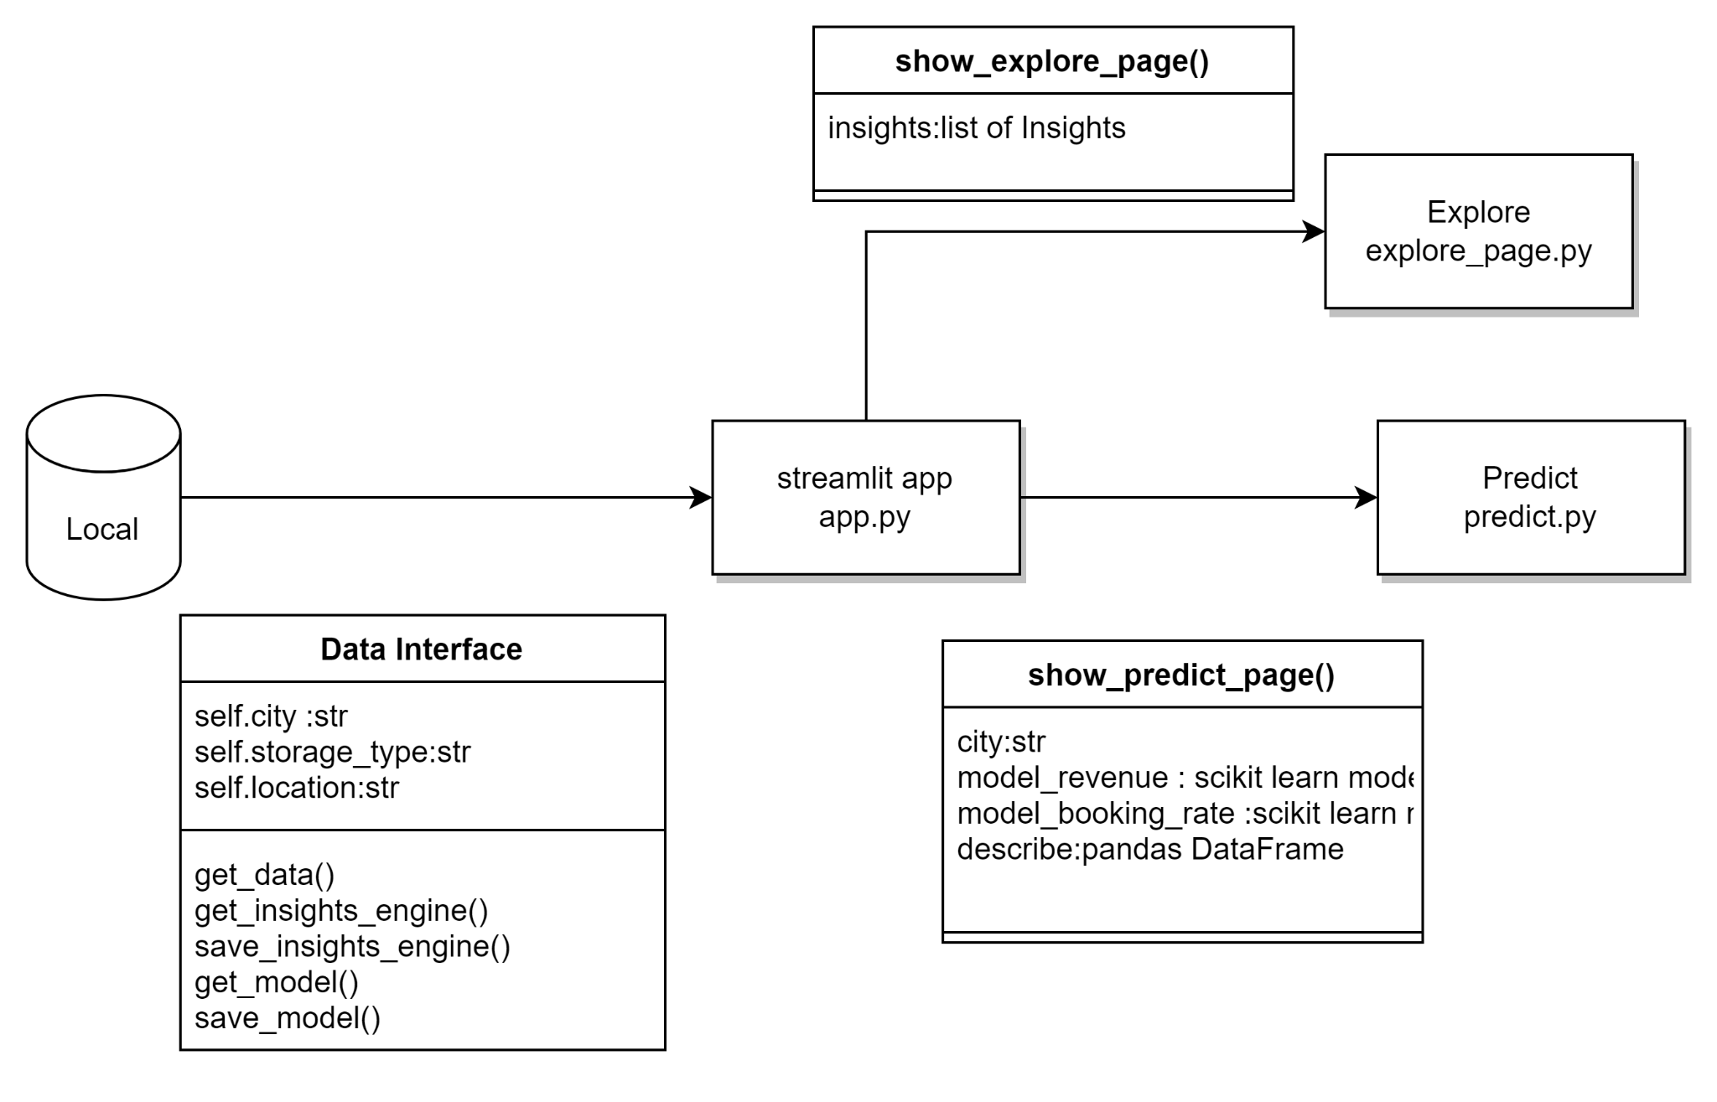
Streamlit UI

Slide 24
Deployment on Streamlit Cloud
requirement.txt
ephemeral storage

Slide 25
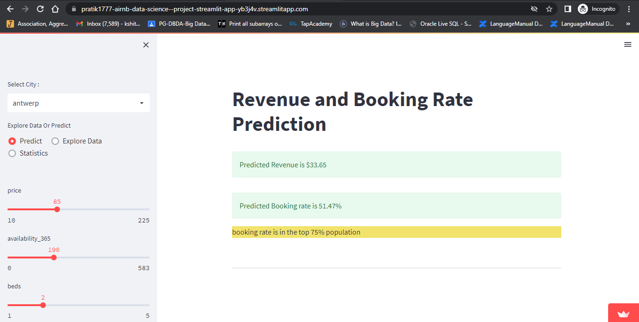
https://pratik1777-airnb-data-science--project-streamlit-app-yb3j4v.streamlitapp.com/

Slide 26
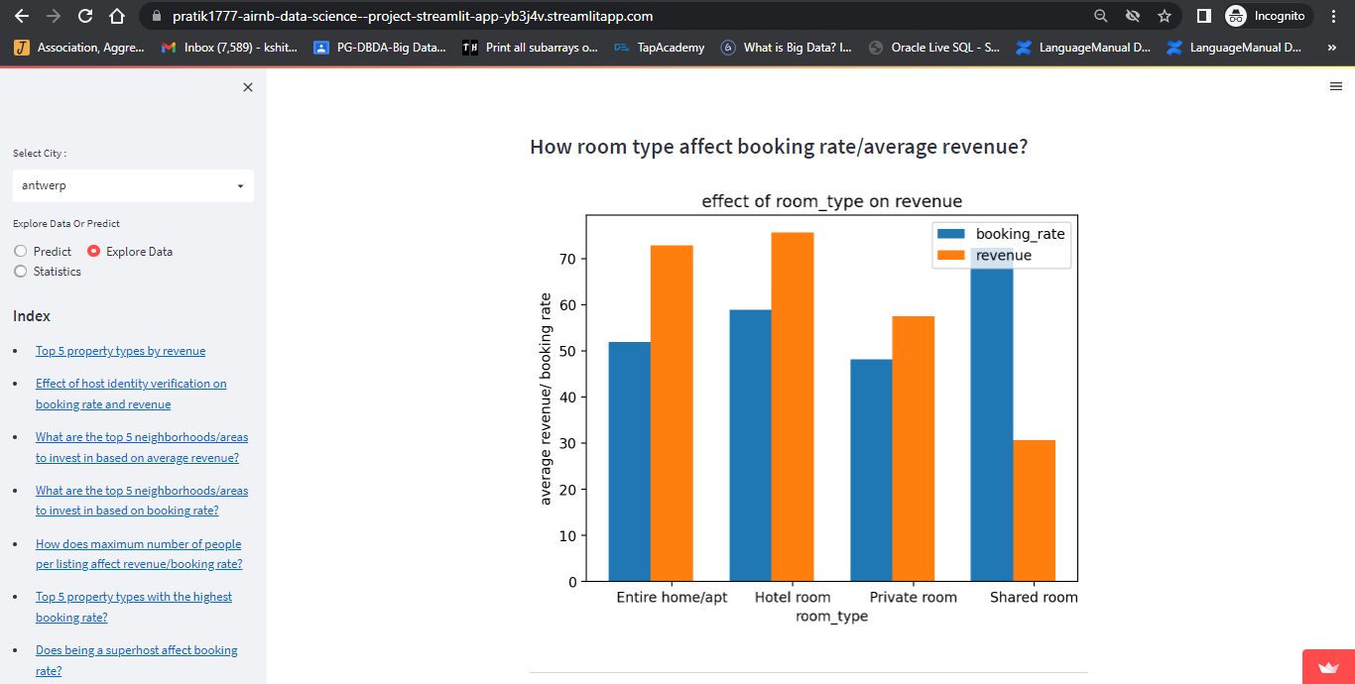

Slide 27
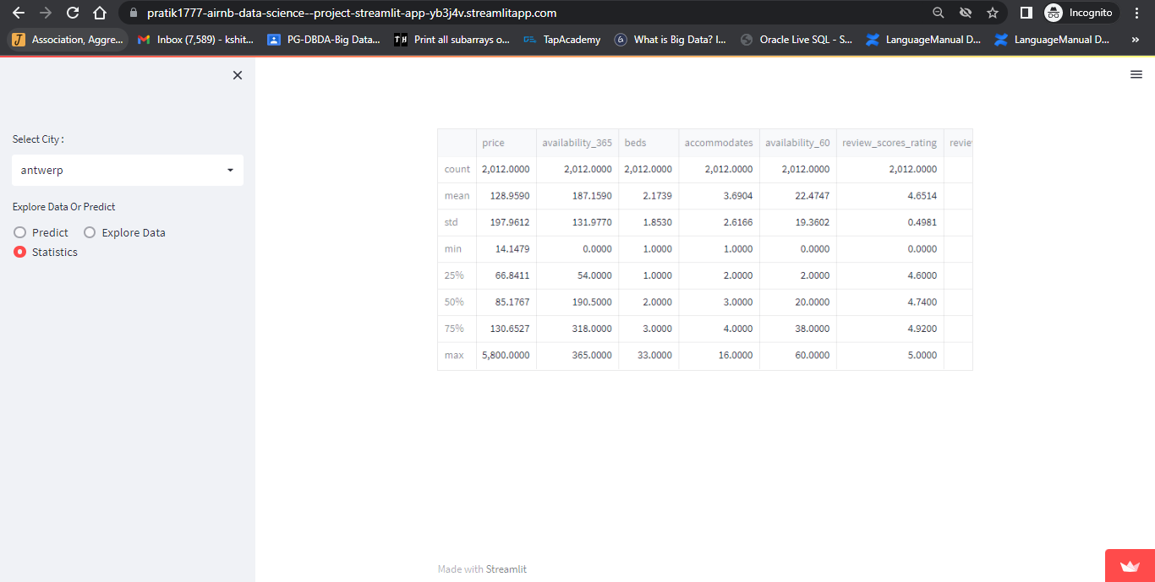

Slide 28
Airflow (Data pipeline)
Workflow engine to schedule and run data pipelines.
Features
Easy to Use
Open Source
Robust Integrations
Amazing User Interface

Slide 29
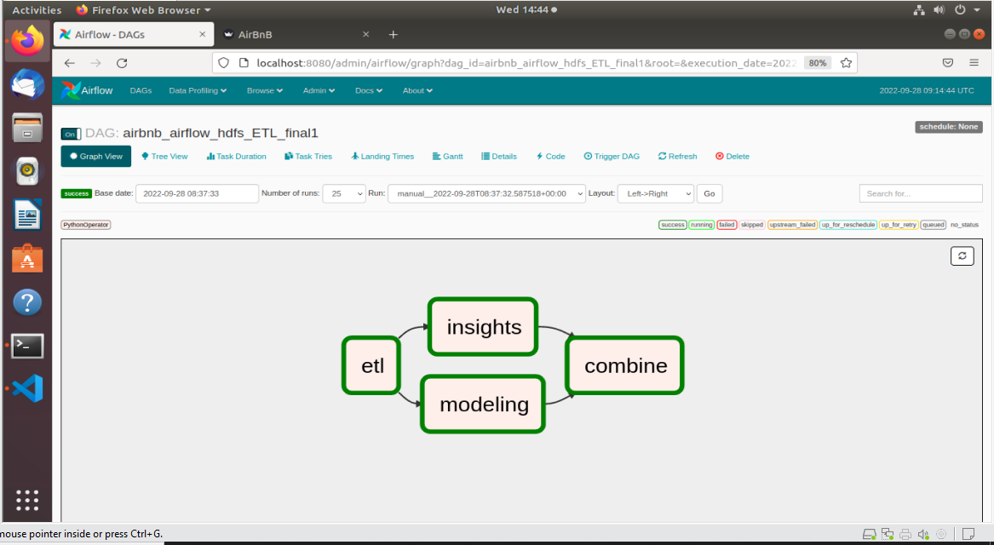

Slide 30
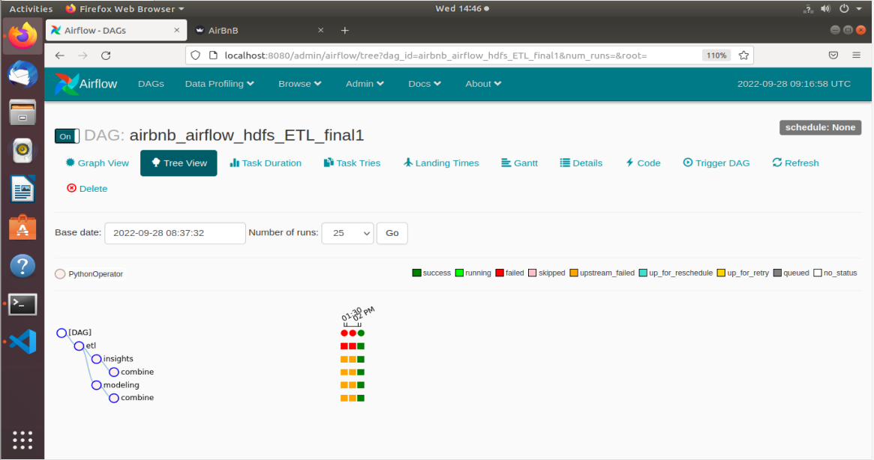

Slide 31
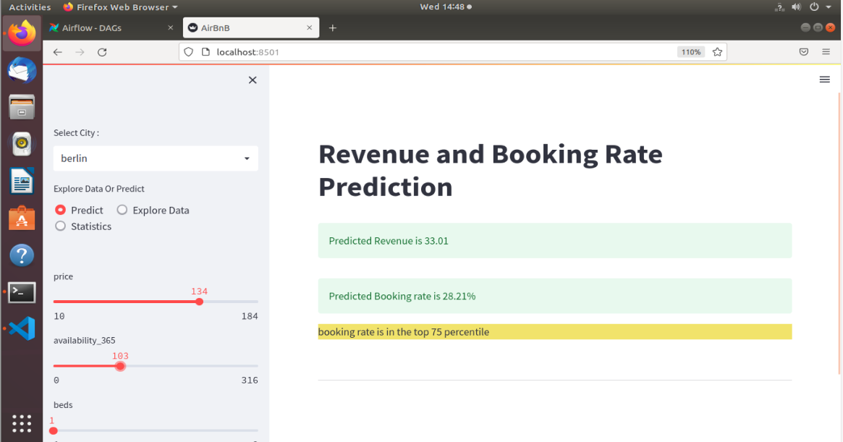

Slide 32
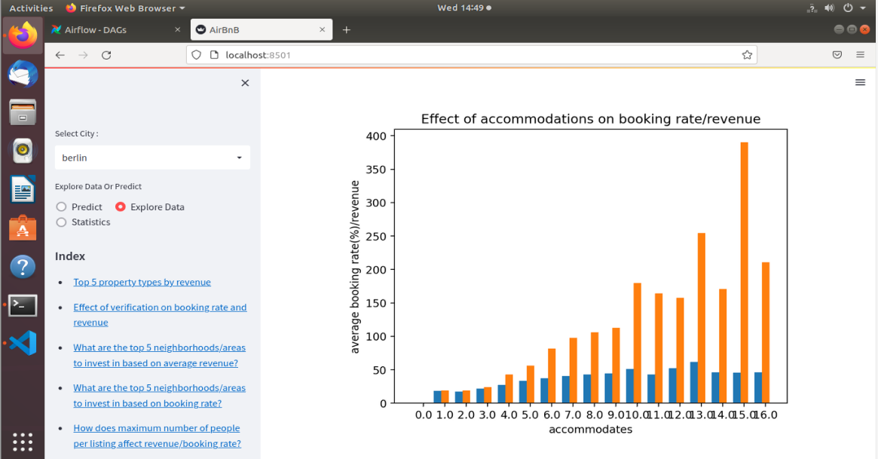

Slide 33
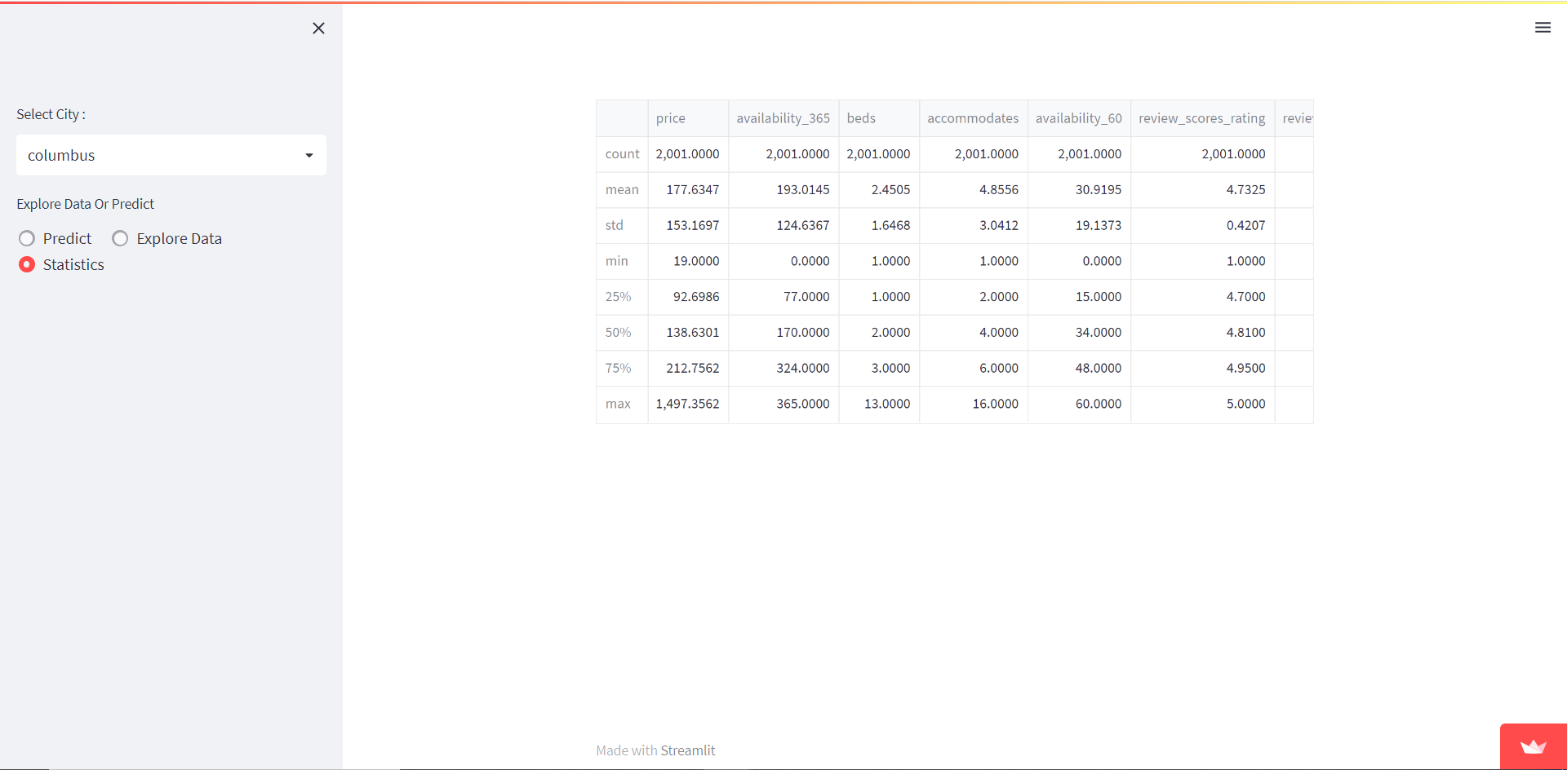

Slide 34
Internal UI

Slide 35
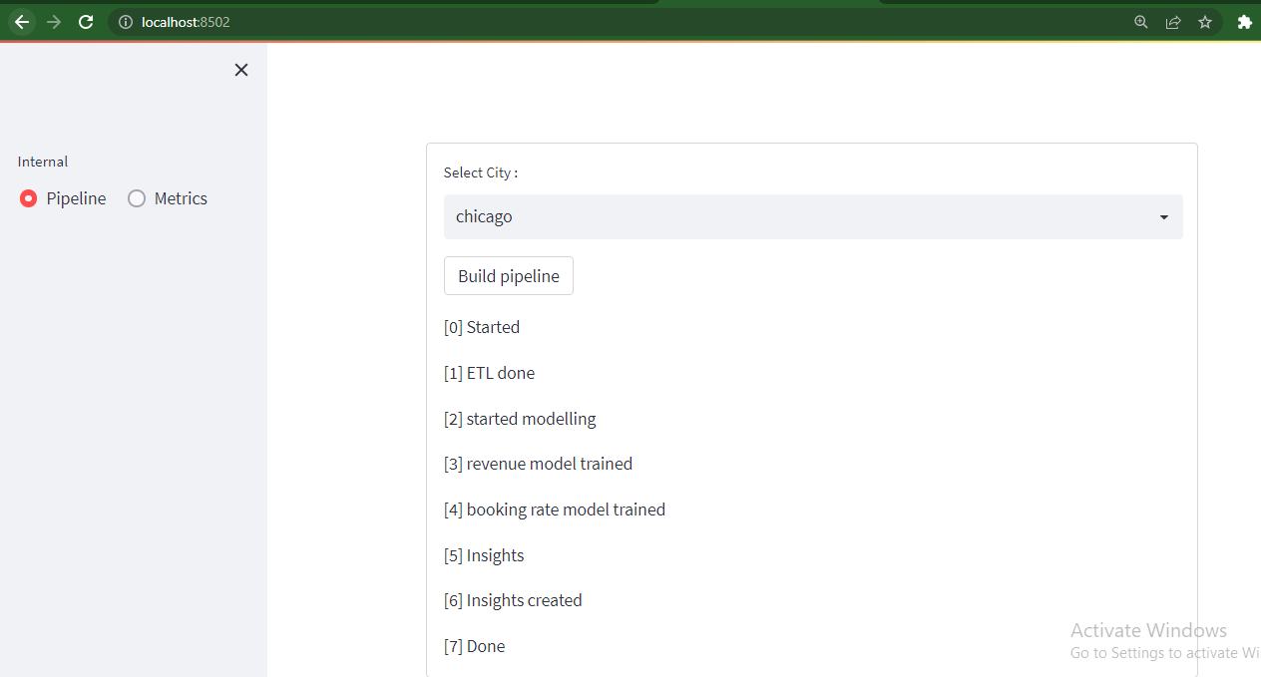

Slide 36
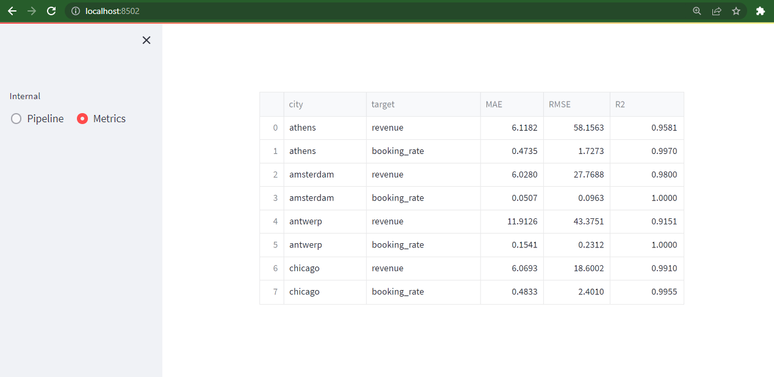

Slide 37
HDFS Data Warehouse

